Slide 1
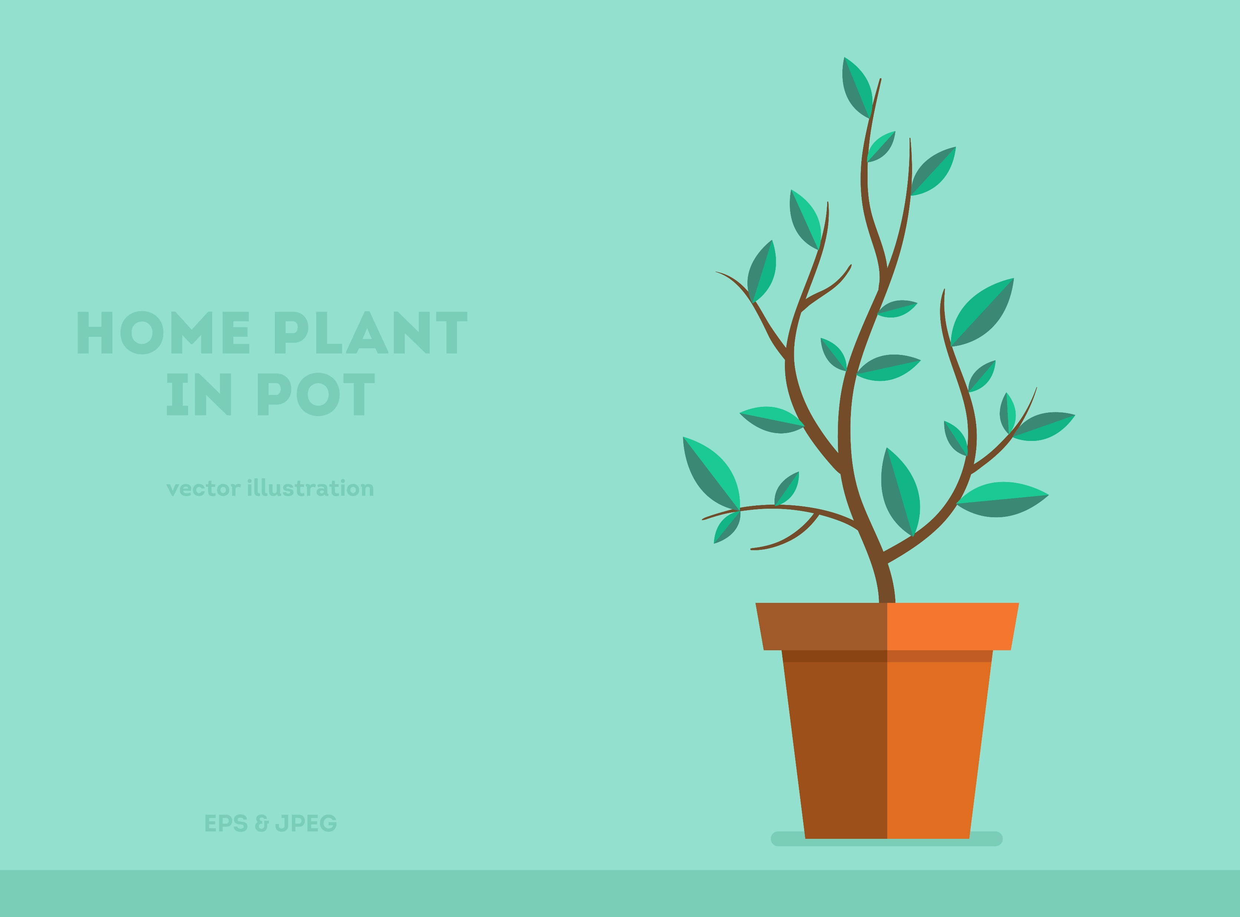

SKYNET 1.0
PLANT AI BOT
From: Thunders From The Sky
Jayaprakash M
CSE 2ND Year
Krishna Kumar M
CSE 2ND Year

Slide 2


SKYNET 1.0
Table of Content
Problem Statement
and Solution
Applications
Page 3-4
Page 5
Tech-stack
Marketing/Budget and Conclusion
Page 6
Page 7-8
PLANT AI MATE
GCT IEEE STUDENT BRANCH

Slide 3

SKYNET 1.0
PROBLEM STATEMENT
Plants are considered living beings biologically, yet technologically, they lags. So, majority of people do not regard plants to be living entities in this world, Perhaps that's why not everyone wants to be a gardener. The main reason for this is that they do not engage in active conversation with us. The chemistry between the earth and the human is expressed by means of the messenger named flora (Plants and Trees). But the relationship is getting farer day by day
Thunders From the Sky
GCT IEEE STUDENT BRANCH

Slide 4
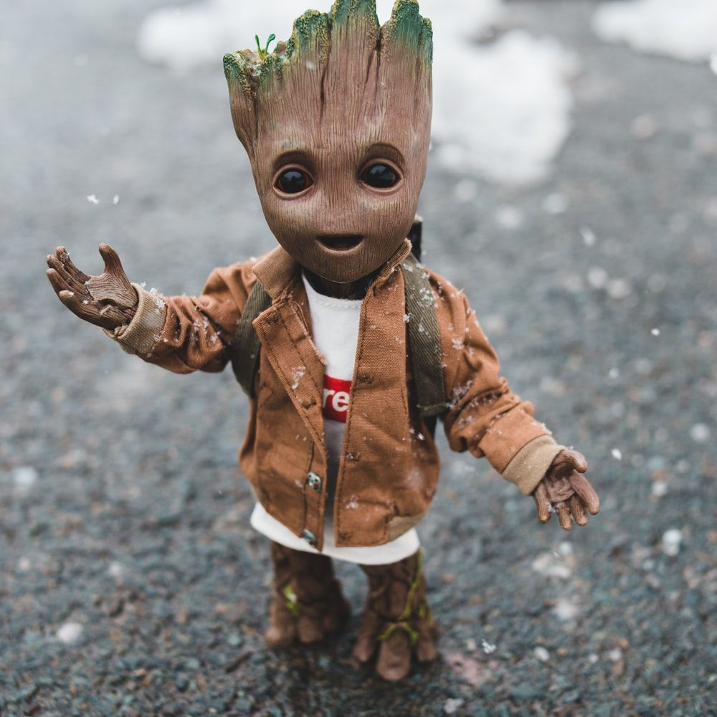
SKYNET 1.0
SOLUTION
BRINGING BACK TO LIFE.
We were developing the ability for a plant to express its emotions. Consider what it would be like if it greeted you every time you passed by. What if it requests you to water it? If the soil's moisture level drops. What if it sent a quote to you every day? What if it prompts you to pick up the ripe fruits and dazzling flowers? What if it informs you of its current height? You can share your feelings
All of this may lead humans to perceive plants and trees as part of their family.
We call it Plant AI-Mate
PLANT AI BOT
GCT IEEE STUDENT BRANCH

Slide 5
SKYNET 1.0
Applications of PLANT AI-MATE
01
02
03
Personal Assistant
Go Green before
Green goes
Teaches Us
None in this real world are trustworthy to share our feelings but it can hold be….
If people started linking it. Then its very probable to find at least one plant in every house
It evident that agriculture is suppressed in every humans. It will induce to bring it out
04
05
06
Importance of Agri
Plant POV
Monitors the life cycle
It will evident the Importance of Agriculture to the
Instagram -culture
If we started to see from the plant’s point of view of this world, it will open a new universe to explore
It keeps measuring all the properties of plants that helps us to study and research further on this.
PLANT AI-MATE
GCT IEEE STUDENT BRANCH

Slide 6
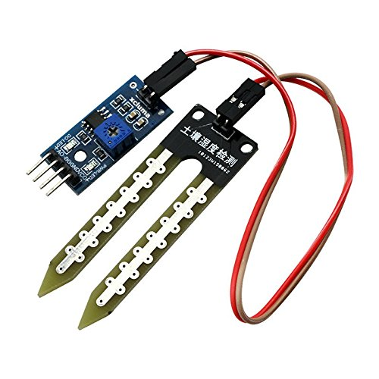
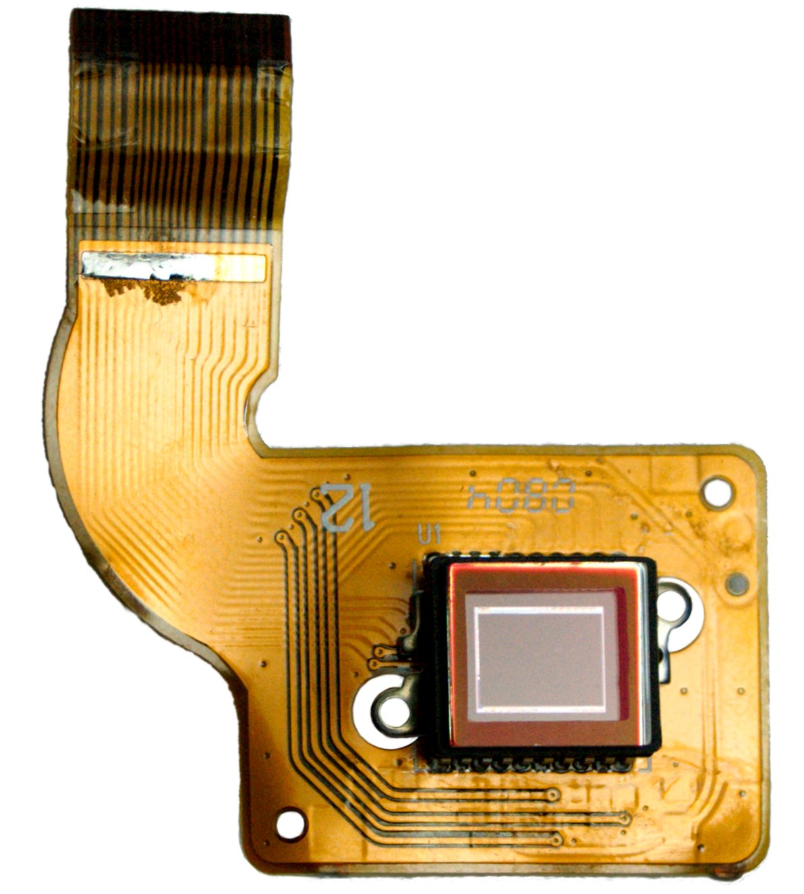
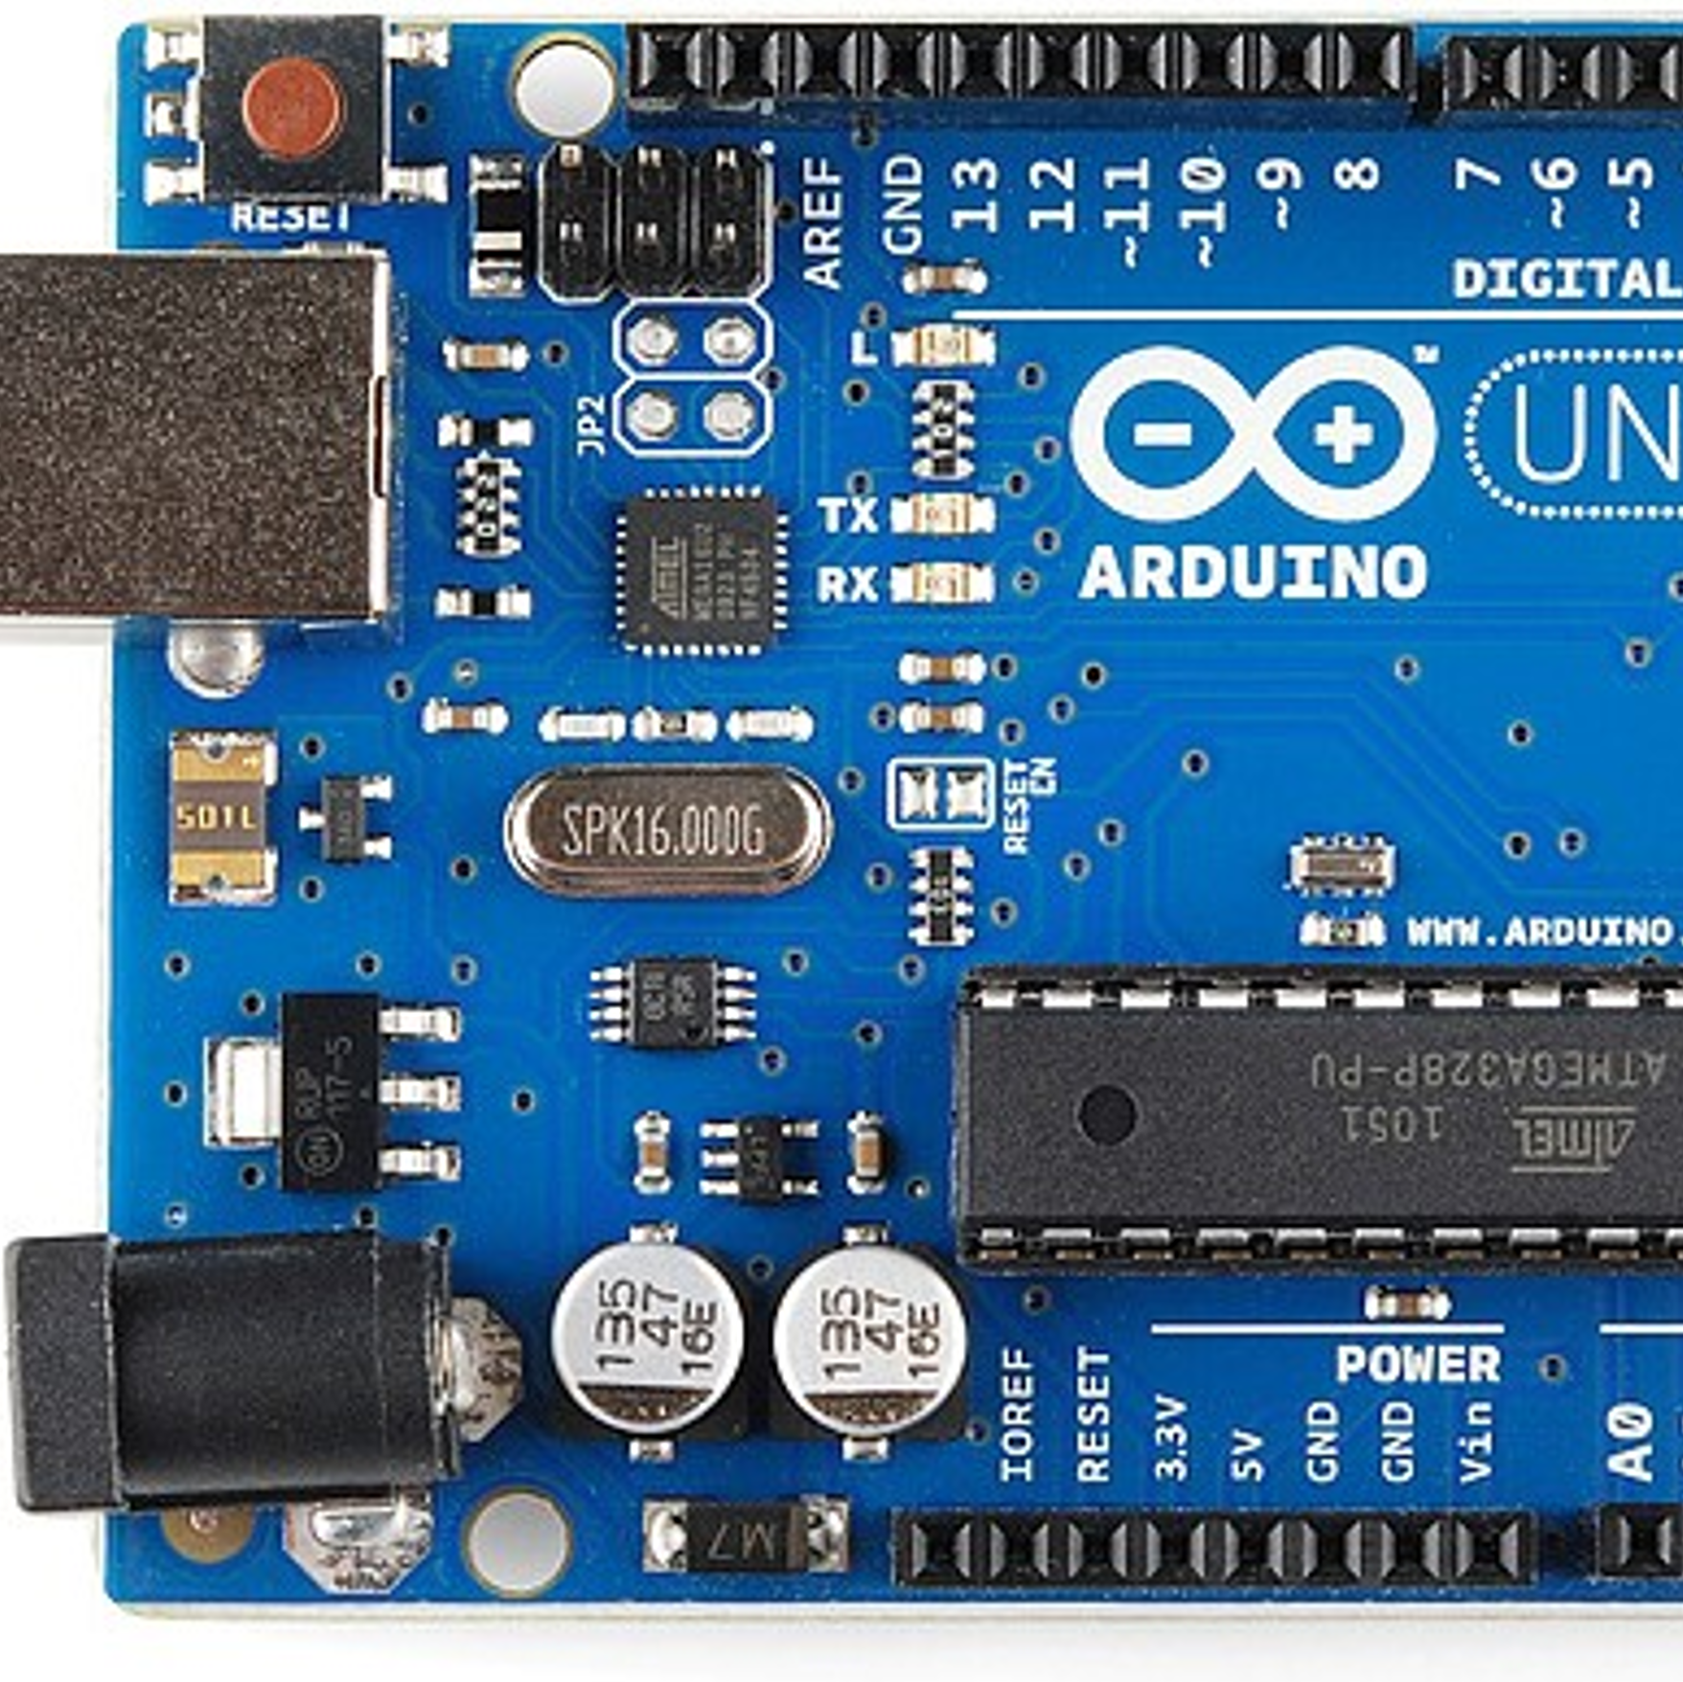
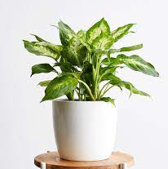

TECH STACK
SKYNET 1.0
Monitoring Sensors
Interaction Sensors
Micro-controller
Gardening tools
Others
Moisture Meter
Ultrasonic sensor
Photoresistor
Nutrition level
Etc…
Image Sensor
Microphone Sensor
Mini Speaker
Microcontroller capable of doing basic daily tasks and activities
Plants
Plant Pots
Other
essential Products
Mini Storage to store Essential Softwares Open CV data, and statistics of plant growth and AI files
PLANT AI-MATE
GCT IEEE STUDENT BRANCH

Slide 7
Marketing Strategy
Affordable
Each One, Plant One
Its crafted not only for high class
But also, for common people
Promotion of slogans and government schemes that induce government contribute on this project
100% Privacy
Less competition
As we are not having any connection between the device and company after selling , there is no need of afraid privacy issue
As no company involved in selling Plant AI-Mate, we would be the ruling party. As like “First Come, Take all” policy
Free Trails
Multi Language Support
The initial release of the product of limited count will be issued for free for those who have regular gardening habits
Its not only for educated ones, but also for the illiterates

Slide 8
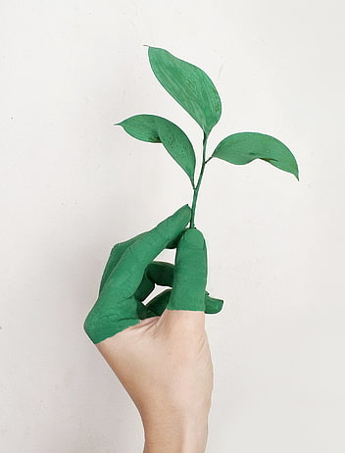
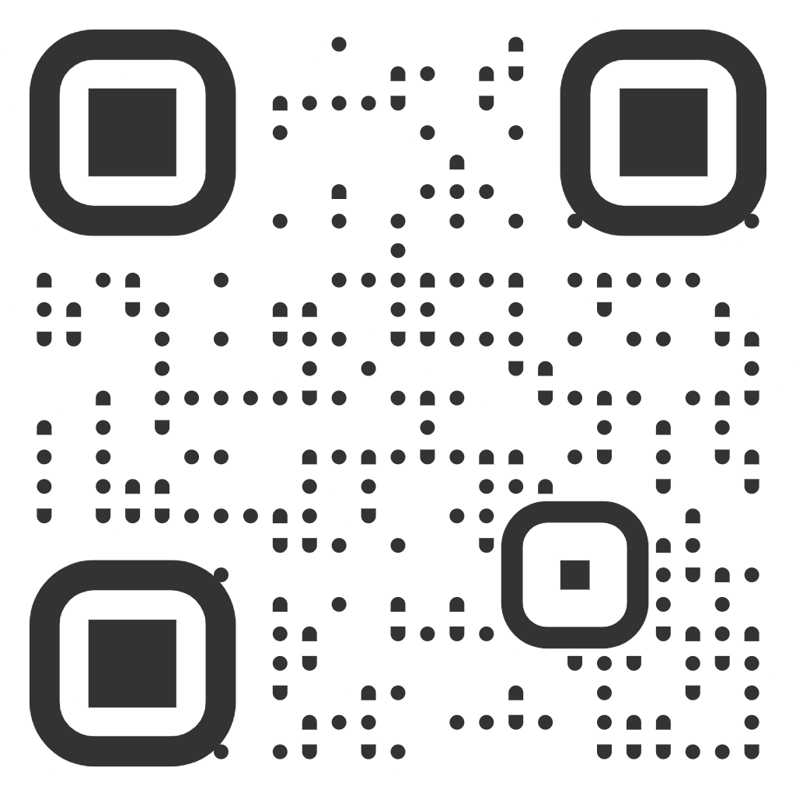
Conclusion and Bibliography
PLANT AI-MATE
GCT IEEE

